Slide 1
Informatics Tools for Biodiversity Data Conversion
Kittinan Ponkaew
VisLab, Osaka
8/14/2013

Slide 2
Week 7 Progress
Made important documentations. About 50% done. Should be easily replicated if instructions are followed.
Data conversion works well with Specify 6.5 now. Botany, birds, mammals, and entomology database works.
Had problems with herpetology. Data query is limited by default. Exporting will require more time. Paleontology data is missing complete locality database for now.

Slide 3
Plans for Week 8
Continue working on the herpetology data set.
Finish up important documentations.
Set up attachment server, allowing the database to be queried directly using the default web portal.
Back up important data so that it can we used later on.

Slide 4
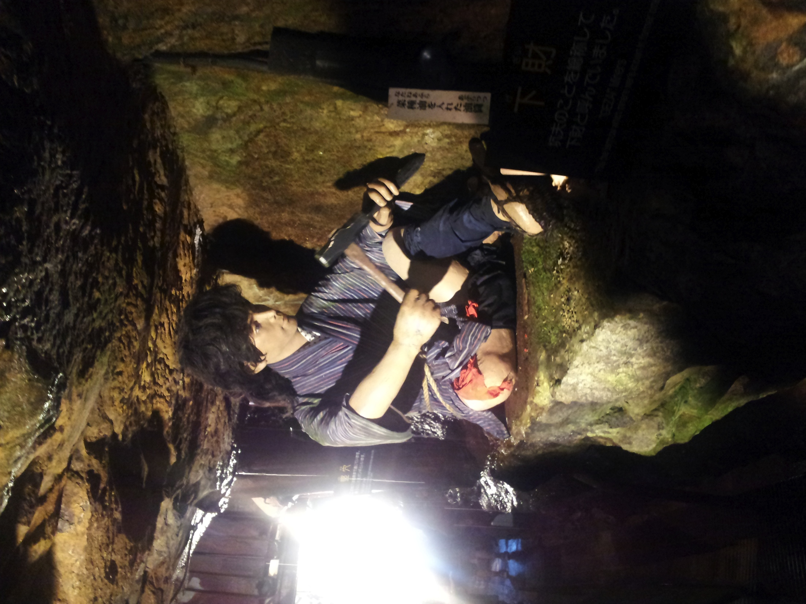
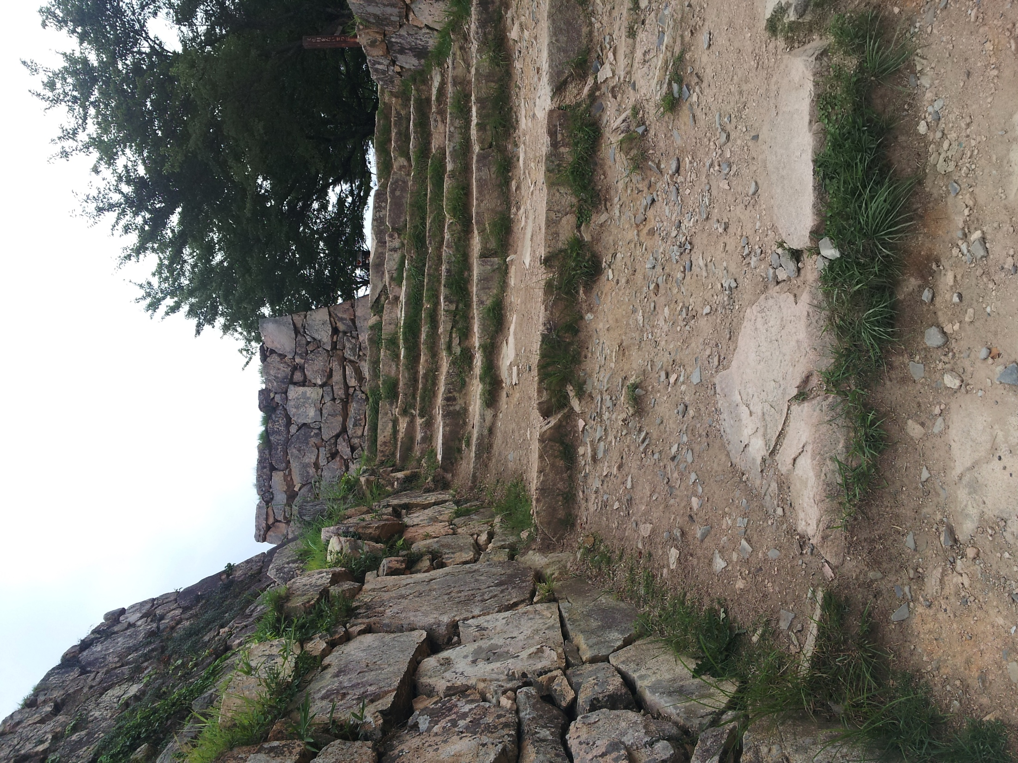
Cultural Exploration
Takeda castle… or what’s left of it
Ikuno silver mine

Slide 5
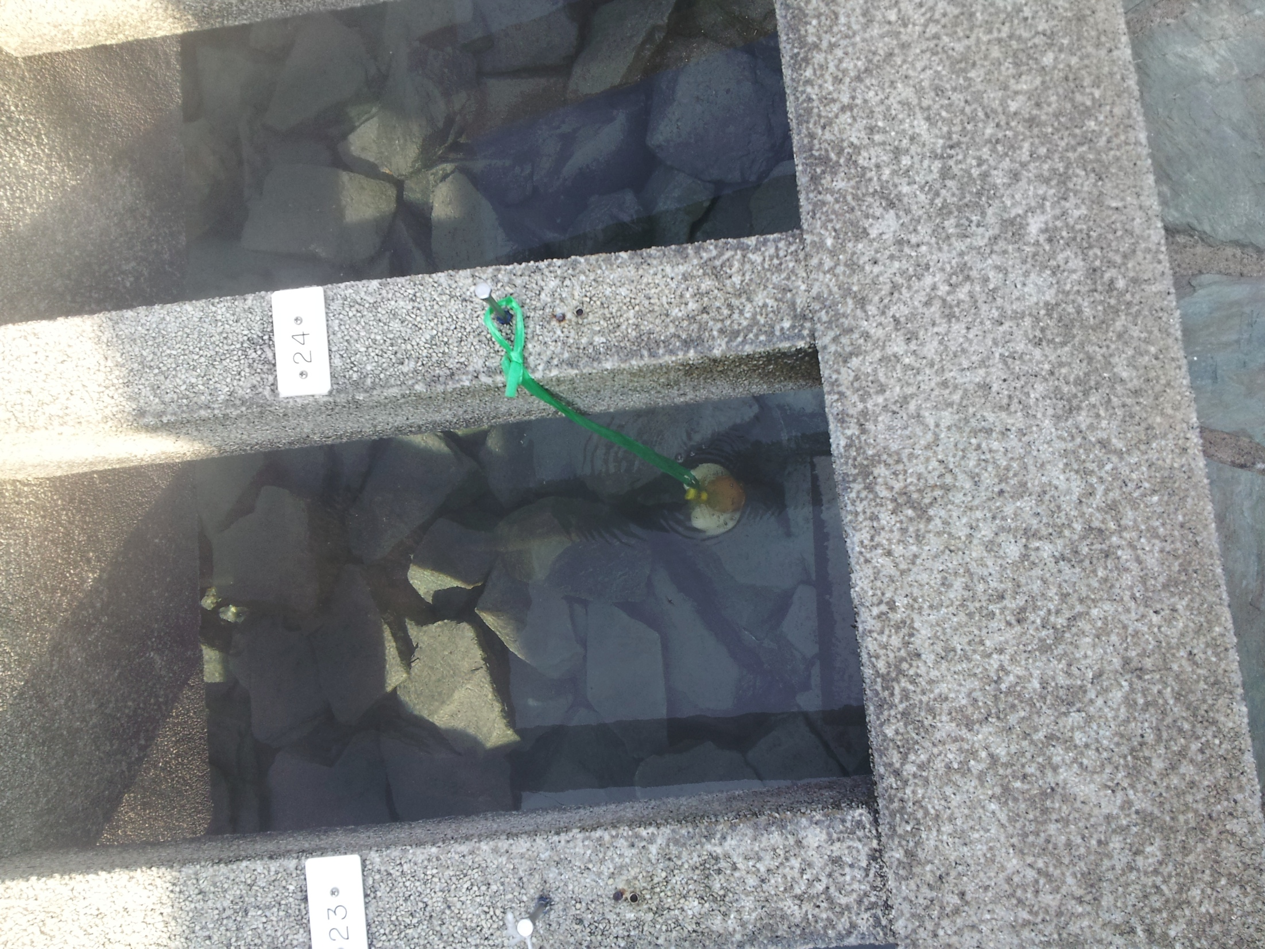
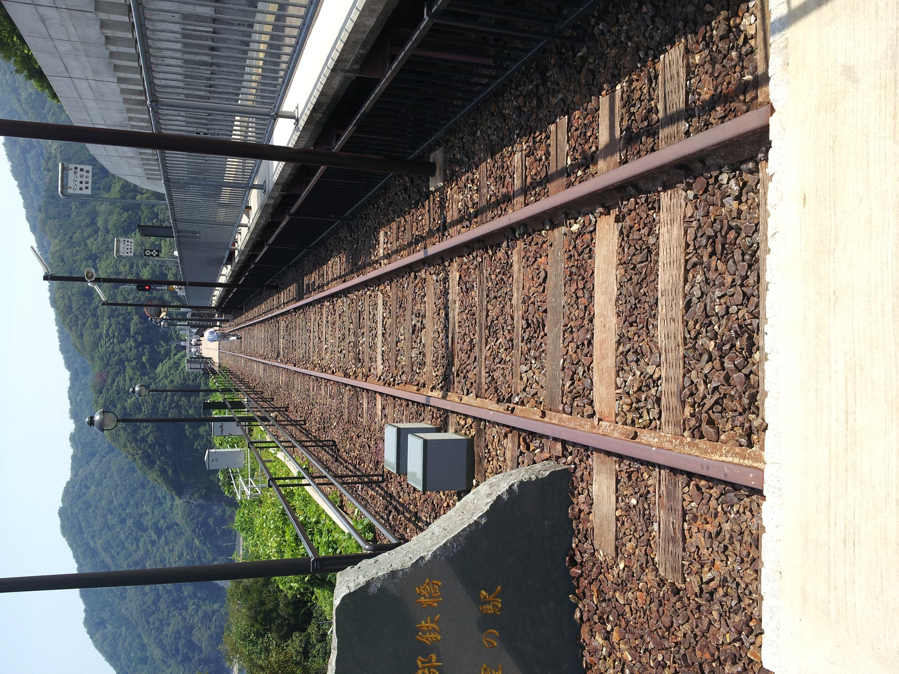
Cultural Exploration 2
Cooking eggs in hot spring.
The hot spring was great!
The old 鉄橋 accrossing the
valley between two mountains.

Slide 6
Acknowledgement
Gabriele Wienhausen
Dr. Jason Haga
Dr. Shinji Shimojo and NICT
PRIME
Balboa Park Online Collaboration
PRIME alumna Haley Hunter-Zinck
NSF

